Slide 1

Journal Report
Chemical Fate of Oils on Indoor Surfaces:
Ozonolysis and Peroxidation
Zilin Zhou, Leigh R. Crilley, Jenna C. Ditto, Trevor C. VandenBoer, and Jonathan P. D. Abbatt
Environ. Sci. Technol. 30 August 2023
DOI:10.1021/acs.est.3c04009
许继文
2023.09.15

Slide 2
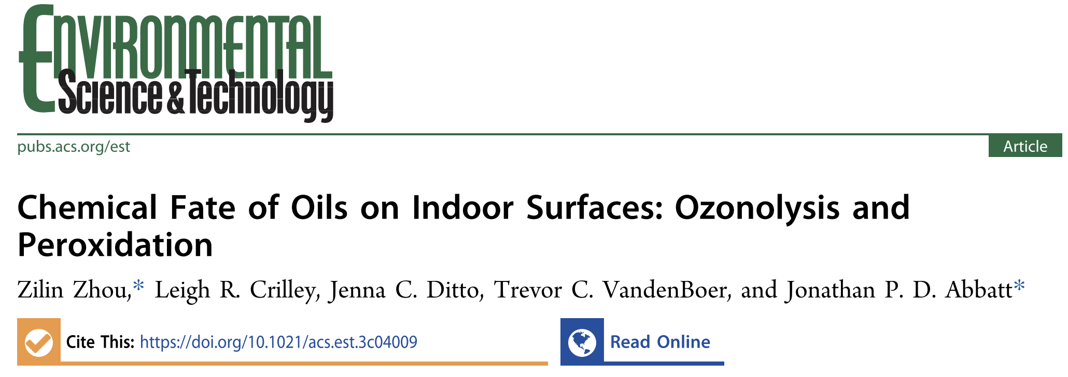
Content
Background
Study Design
Result
Conclusion

Slide 3
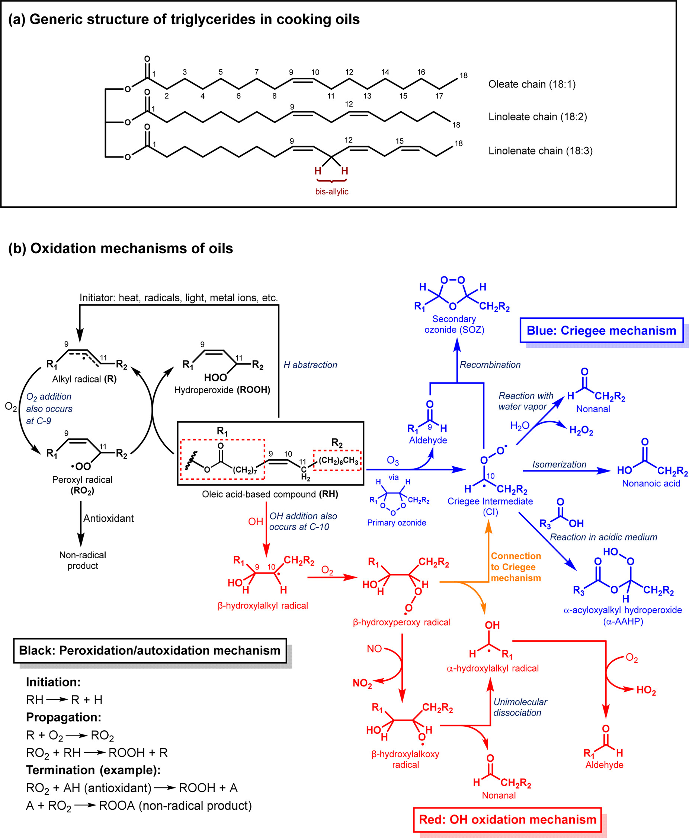
Background
Unsaturated triglycerides found in food and skin oils are reactive in ambient air. However, the chemical fate of such compounds has not been well characterized in genuine indoor environments.
Notes:
Organic films develop on indoor surfaces largely through the emission and deposition of semivolatile organic compounds arising from human occupants and consumer products.
on kitchen surfaces, cooking oils age and accumulate after the deposition of large oil droplets and small cooking aerosol particles.
Such films containing unsaturated triglycerides with oleate, linoleate, and linolenate(林呢林-） chains react with ozone

Slide 4
Background
reaction mechanisms
Notes:
Using oleic acid-based compounds as an example, Figure b (blue section) shows the important steps in ozonolysis. Specifically, this multiphase oxidation pathway proceeds via reactive Criegee（课rain衣） Intermediates (CIs).
Depending on the ambient conditions, the starting lipid may form stable products such as secondary ozonides (SOZs or 1,2,4-trioxolanes) or α-acyloxyalkyl hydroperoxides (α-AAHPs) that contribute to indoor film growth. Meanwhile, the cleavage of carbon−carbon double bonds also emits volatile organic compounds (VOCs) like nonanal, some of which are known respiratory irritants.
With respect to ozone loss, previous measured yields of nonanal emission. its the most abundant indoor VOC (≥3.5% yield) produced by ozonolysis.
another important degradation pathway for cooking oils is Heating. Facilitated by water vapor, a portion of triglycerides decomposes to free fatty acids (e.g., oleic acid) that further react with ozone or hydroxyl radical (OH).
when indoor ozone was sufficiently low, OH-dominated mechanism was suggested. This process is accelerated through cooking with gas stoves, due to the release of nitrogen oxides and nitrous acid (HONO) that enhances the indoor OH level via photodissociation. As shown in the red section of Figure b highlighting the major steps, direct OH oxidation leads to aldehyde formation under elevated NO levels.
high frying temperatures can induce hydrogen abstraction reactions of the triglyceride, following the lipid peroxidation mechanism (black section of Figure b).

Slide 5
Background
primary objectives:
(1) validate the significance of ozonolysis in indoor multiphase oxidation;
(2) identify common oxidation products in aged indoor oil films;
(3) characterize the dominant oxidation mechanism(s) for different indoor conditions.
Notes:
with a focus on the reactive triglycerides, the primary objectives were to

Slide 6
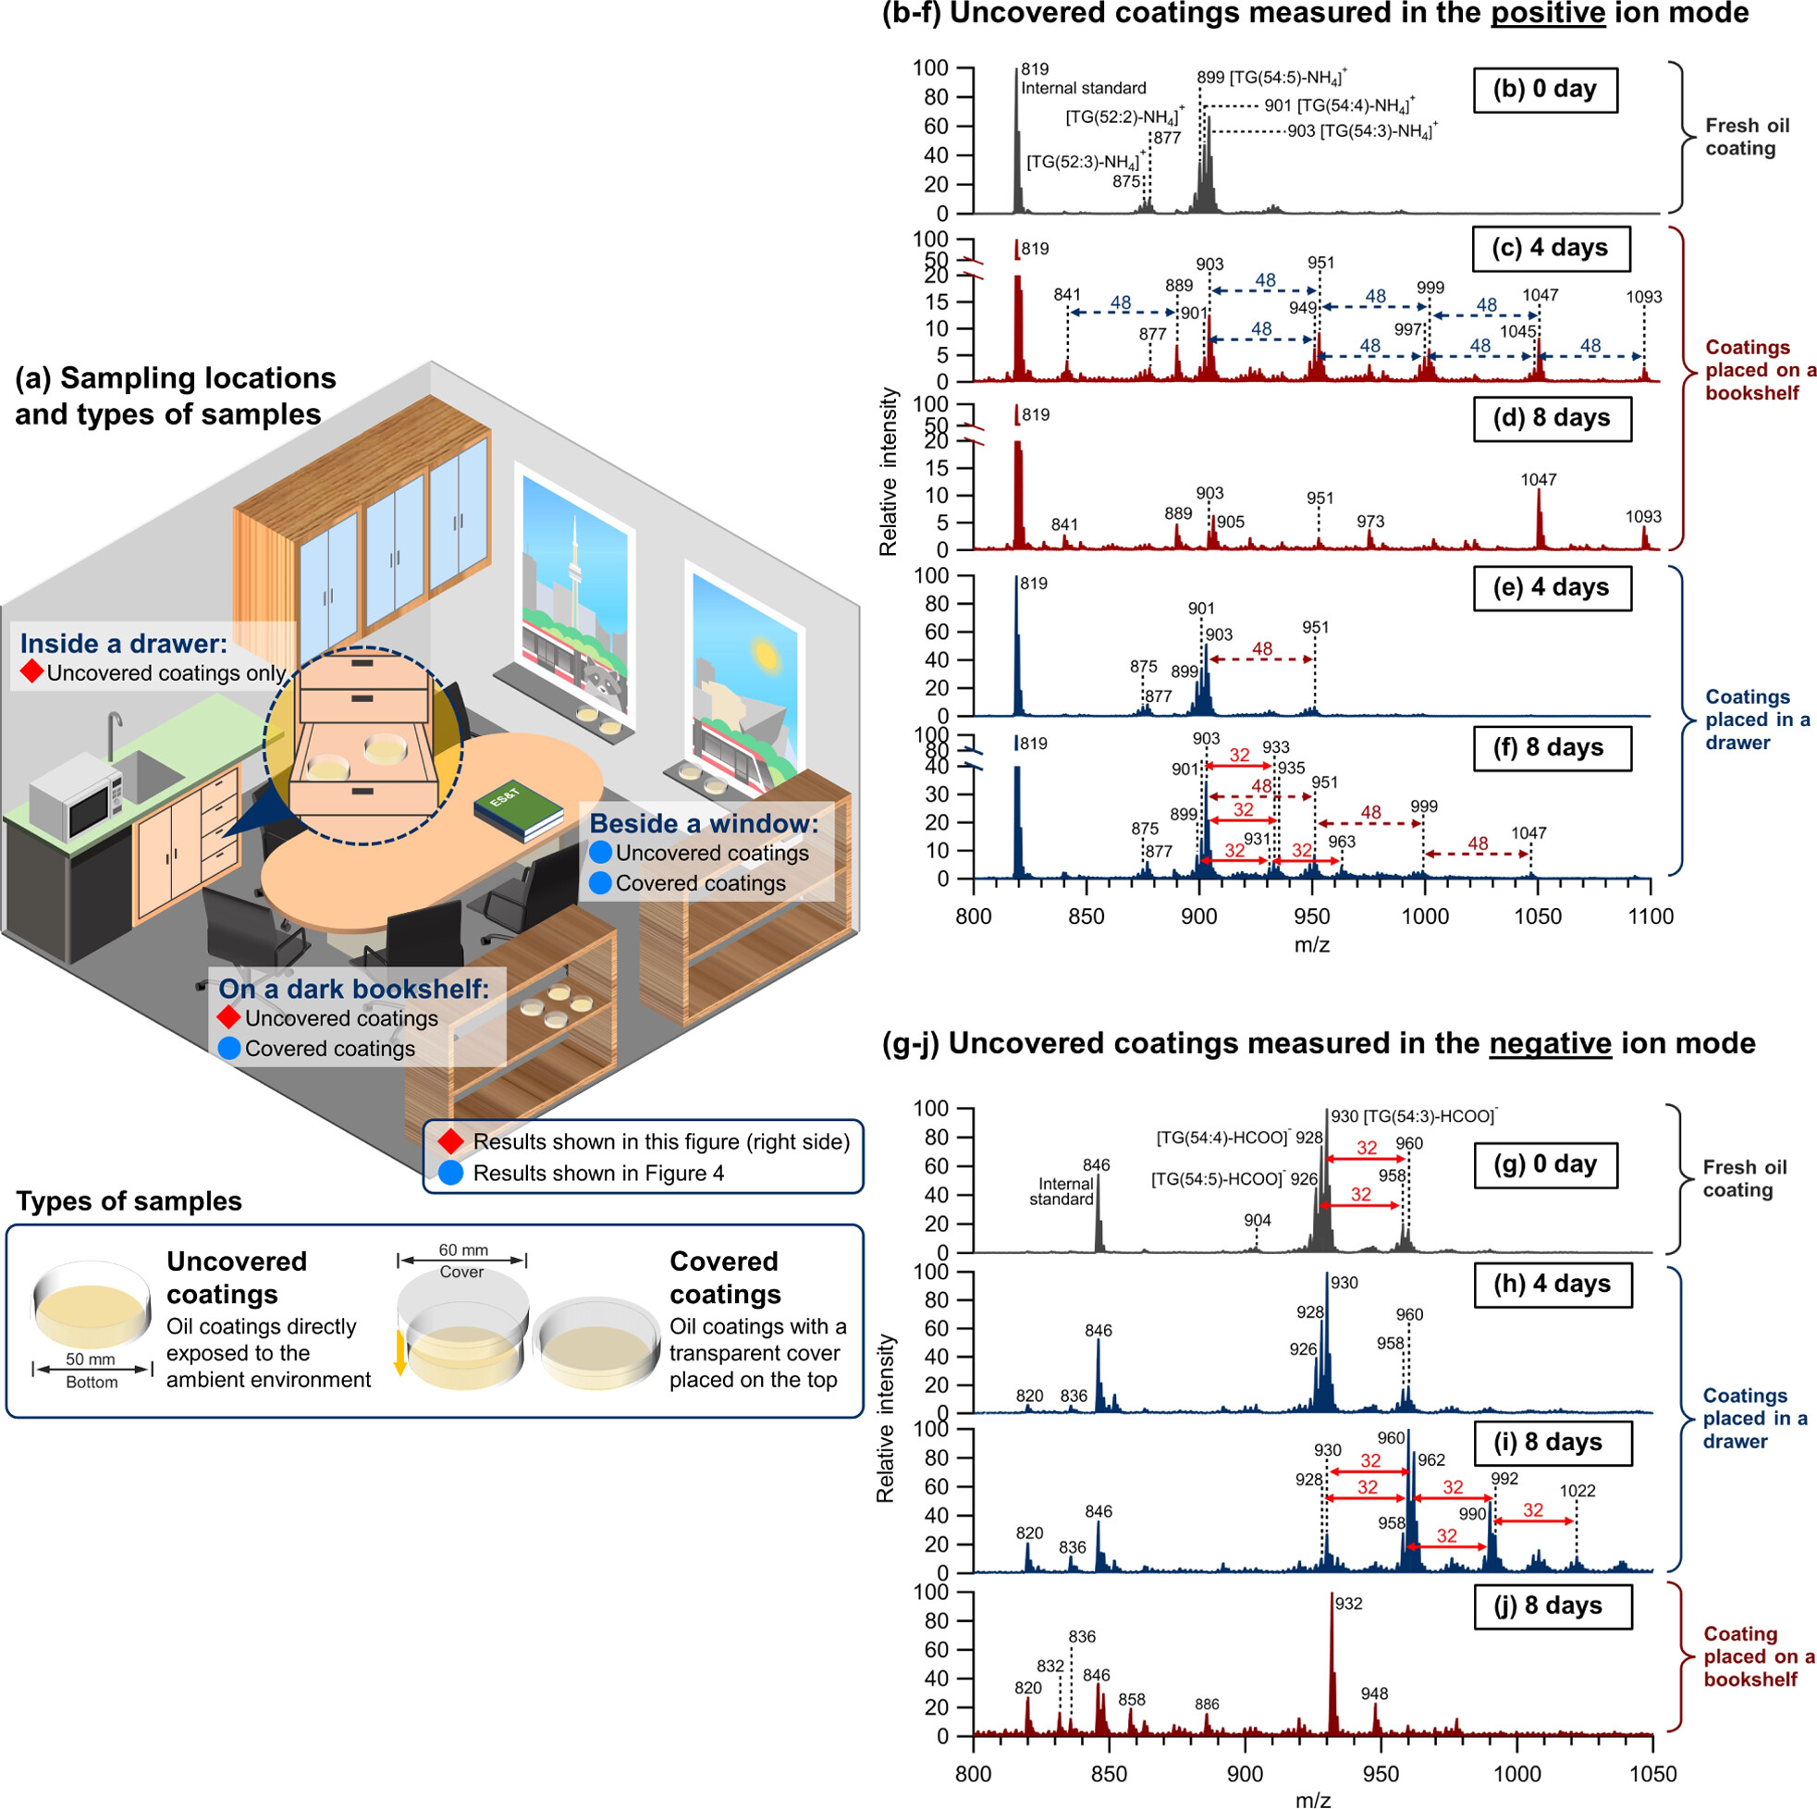
Study Design
MATERIALS
For coating deposition, 500 μL of canola oil in chloroform (∼0.1% v/v) had the solvent fully evaporated inside clean glass Petri dish bottoms (∼50 mm diameter, VWR).
The finished coatings (∼0.25 μm average thickness) were fully sealed under parafilm prior to transportation to the sampling sites (cafeteria kitchen or office).
After an exposure period, the aged coatings were sealed under parafilm before immediate extraction in the laboratory.
types of samples
Notes:
All predeposited oil coatings were prepared in a chemical laboratory fume hood, and no chemicals were directly used at sampling sites.

Slide 7
Study Design
INSTRUMENTS
purpose | instruments
monitor and characterize the oil decay and products | electrospray ionization mass spectrometry (ESI-MS) proton nuclear magnetic resonance (¹H NMR).
examine the formation of organic radicals on surfaces | Electron paramagnetic resonance (EPR) spectroscopy

Slide 8
Study Design
Indoor Sampling 1: Cafeteria Kitchen
layout | purpose
several clean Petri dish bottoms (without covers) were horizontally placed approximately 1m from the active cooking area with daily frying activities | collect surface oil deposition resulting from cooking
predeposited canola oil coatings were placed in the business area of the kitchen (∼5 m away from the cooking area and ∼2 m above the ground) | support product analysis
a clean Petri dish bottom was also placed on the business area to ensure that the interference from additional cooking-related deposition was minimal. | control sample

Slide 9
Study Design
Indoor Sampling 2: Office
layout | purpose
0.25 μm-thick uncovered canola oil coatings were placed on a dark bookshelf and inside an enclosed drawer in the same room for a maximum of 8 days. | compare the oxidation products at ozone-abundant and ozone-limited locations
additional oil coatings were loosely covered by transparent Petri dish covers prior to their placement beside a south-facing window receiving direct sunlight | study the possibility of indoor photooxidation
identical covered oil coatings were also placed on the dark bookshelf at the same time, where the sampling period was up to 16 days after placement. | for comparison for the temperature by the window which could be a few degrees Celsius higher than the interior on bright days and lower on cloudy days and nights
Notes:
experimental condition：22−24 °C temperature,6−18 ppb ozone, and 20−50% relative humidity // The outdoor weather during the sampling period (up to 8 days) was mostly sunny or partially cloudy with at least 12 h of daylight.
layout2目的：As physical barriers, the loosely fitting covers significantly reduced the mass transfer rate of air over the films. This procedure restricted the ozone flow while maintaining a source of oxygen, without further attenuating indoor sunlight.

Slide 10
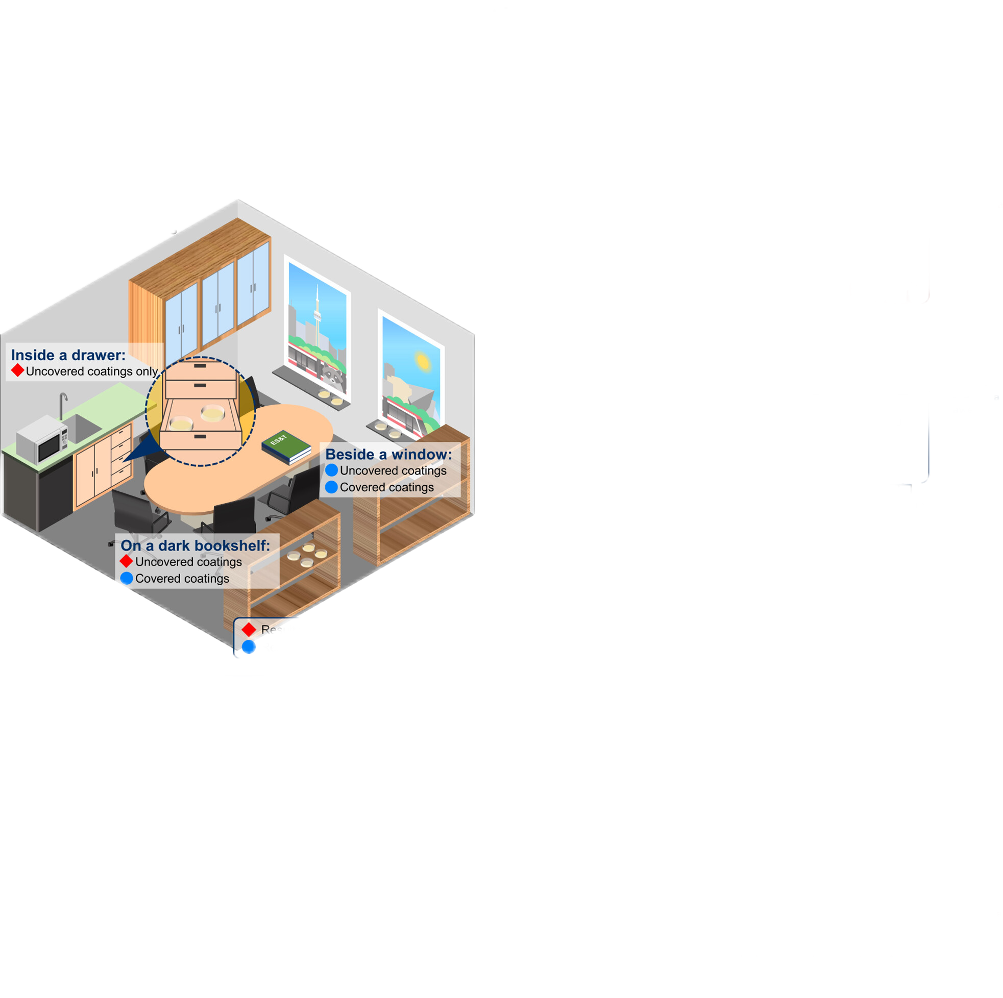
Study Design
Indoor Sampling 2: Office
sampling locations

Slide 11
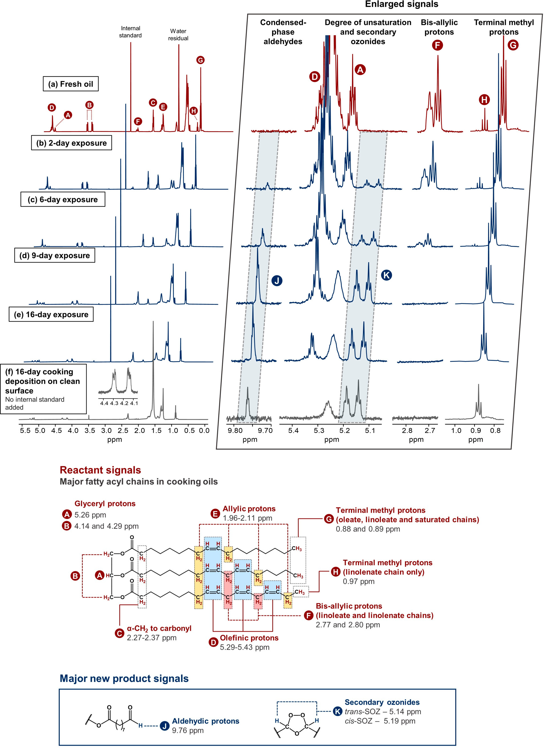
Result
1.Multiphase Ozonolysis of Cooking Oil in a Cafeteria Kitchen
dimethyl sulfone (DMSO₂)
NMR spectra of the oil coatings before and after air exposure up to 16 days
Notes:
this figure presents the NMR spectra of the oil coatings before and after air exposure up to 16 days with signals labeled with A−H corresponding to
the characteristic signals of the unsaturated triglycerides. these oil coatings were placed at a sufficient distance from the active cooking area to avoid additional oil particle.

Slide 12
Result
1.Multiphase Ozonolysis of Cooking Oil in a Cafeteria Kitchen
Notes:
We first studied the condensed-phase product composition of the aged oil by fully exposing predeposited canola oil coatings (0.25 μm average thickness) to indoor air in a cafeteria kitchen

Slide 13
Result
signal | integral | explanation
D (olefinic protons) | gradual decrease in the aged samples | the oil reactivity toward indoor oxidants arises from the carbon−carbon double bonds
K (SOZs) | newly formed | the loss of lipid unsaturation is accompanied by the formation of stable secondary ozonides consisting of two triplets
J (aldehydic protons) | newly formed | exhibits the production of condensed-phase aldehydes after oxidation
F (bis-allylic protons) | no longer visible after 9 days | such triglycerides are much more reactive to ozone than those with monounsaturated oleate chains.
D (olefinic protons) E (allylic protons) | still present after 9 days
G&H (terminal methyl protons) | intensity loss | molecular weight loss of the triglyceride due to the release of VOCs
Notes:
The observed formation of SOZs and aldehydes is consistent with the previous study characterizing the products from ozonolysis of pure triolein(try all 林) at elevated relative humidity in a controlled reactor. Hence, in this indoor setting, ozone is the primary oxidant when oil films are exposed to ambient air.
when ozone breaks down the double bond within the linoleate and linolenate(来闹里nate) chains, the resulting intermediate products with 3 or 6 carbons favor volatilization, which in turn makes the SOZ formation pathway less favorable.

Slide 14
Result
1.Multiphase Ozonolysis of Cooking Oil in a Cafeteria Kitchen
signal | integral | explanation
A, B, C | presence | in organic film which were identical to the glyceryl backbone of triglycerides in fresh and aged oils
D, E, F | absence | the deposited oil film was completely saturated
J (aldehydes) K (SOZs) | presence | While the deposition of saturated animal fats is possible, the presence of aldehydes (J) and SOZs (K) in the collected film demonstrates compelling evidence of unsaturated oil ozonolysis.
Notes:
Figure f shows the products accumulated on a clean surface in the proximity of the cooking area (∼1m distance) over a period of 16 days.
the estimated thickness of the collected kitchen film was up to ∼40 nm after 16 days. This is equivalent to a daily growth rate of a few nm, which is at least an order of magnitude larger than the typical reported values on household surfaces, presumably due to the heavy oil consumption and cooking emissions in commercial kitchens.

Slide 15
Result
2.Dark Oxidation Mechanisms Observed in an Office
(with limited air contact)
Notes:
Figure b−f shows the (positive ion mode)-ESI mass spectra of canola oil coatings before and after their placement at dark locations.
Figure c,d shows the product composition in the oxidized coating after room air exposure for 4 and 8 days. In accord with the observations at the cafeteria kitchen, the relative signal intensities of the initial triglycerides (m/z 899−903) with respect to the internal standard (m/z 819) decreased over time.
oil degradation was accompanied by new product signals with an additional three oxygens (i.e., Δm/z = 48) that are well-known as SOZs. Together with condensed-phase aldehydes (e.g., m/z 841 and 889), these products are compelling evidence that oil oxidation on the dark bookshelf was driven by ozone.
In contrast, for coatings placed in an enclosed drawer at the same time, the limited air flow and ozone supply were only capable of partially oxidizing oils to SOZs (m/z 951, 999,1047), consistent with an expected lower rate (Figure e,f). In addition, there was a notable formation of products with an additional 2 oxygens (Δm/z = 32), especially after 8 days of placement. As previously discussed, given that oil autoxidation could occur at room temperature, we attribute such oxygenated products to hydroperoxides (ROOH). To confirm their structures, we analyzed the extracted sample in Figure f with a selective MS/MS method for organic hydroperoxide identification.
Lipid autoxidation can also be monitored through ESI-MS in negative ion mode, a sensitive method of detecting hydroperoxides through formate adducts of the molecular ions. As shown in Figure g−i, the process of triglyceride consumption inside the drawer was observed.
a significant amount of the reactive triglycerides (m/z 926−930) was converted into hydroperoxides, whose growth was observed through multiple m/z
additions of 32 after 8 days.
such products were not observed when the oil coating was exposed to room air where ozonolysis dominated
this ionization mode was not sensitive for detecting SOZs
ozone is the primary oxidant in indoor air. However, in enclosed spaces with limited ozone, autoxidation becomes relatively more competitive.
the source of the chemical agents that initiate the radical chain reaction inside the dark drawer is unclear. Two recent studies proposed that trace amounts of reactive gases, metals, or radicals could act as the initiator.
the oil coating was relatively stable in the drawer for the first 4 days (Figure g,h), Müller et al. also observed an induction period in lipid autoxidation.
Lastly, it is likely that the fresh oil in this study already contained a trace amount of hydroperoxides, due to ions at m/z 958 and 960 in Figure g. This is not surprising as oil degradation and hydroperoxide formation during storage has been documented in the literature.

Slide 16
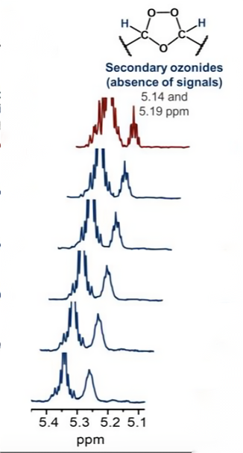
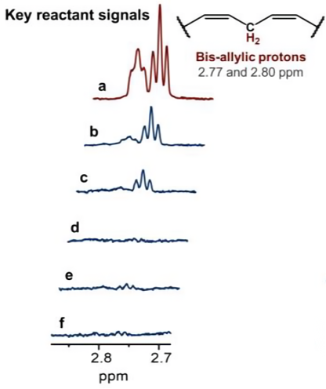
Result
3.Effects of Indoor Lighting
background：
Cooking oils absorb UVA and visible light that overlap with the irradiance of indoor direct sunlight.
setup：
Placing oil coatings by a south-facing window in an office. Loosely covering the oil coatings with transparent Petri dish covers.
instrument：
¹H NMR spectra
Notes:
For this reason, we further investigated the possibility of indoor photooxidation.
To minimize the loss of lipid unsaturation via competing ozonolysis, we optimized the sampling setup by loosely covering the oil coatings with transparent Petri dish covers.
the bis-allylic proton signals (2.77 and 2.80 ppm) disappear，without notable new signals of secondary ozonides at 5.14 and5.19 ppm,
this result indicates that oil degradation was dominated by peroxidation rather than ozonolysis

Slide 17
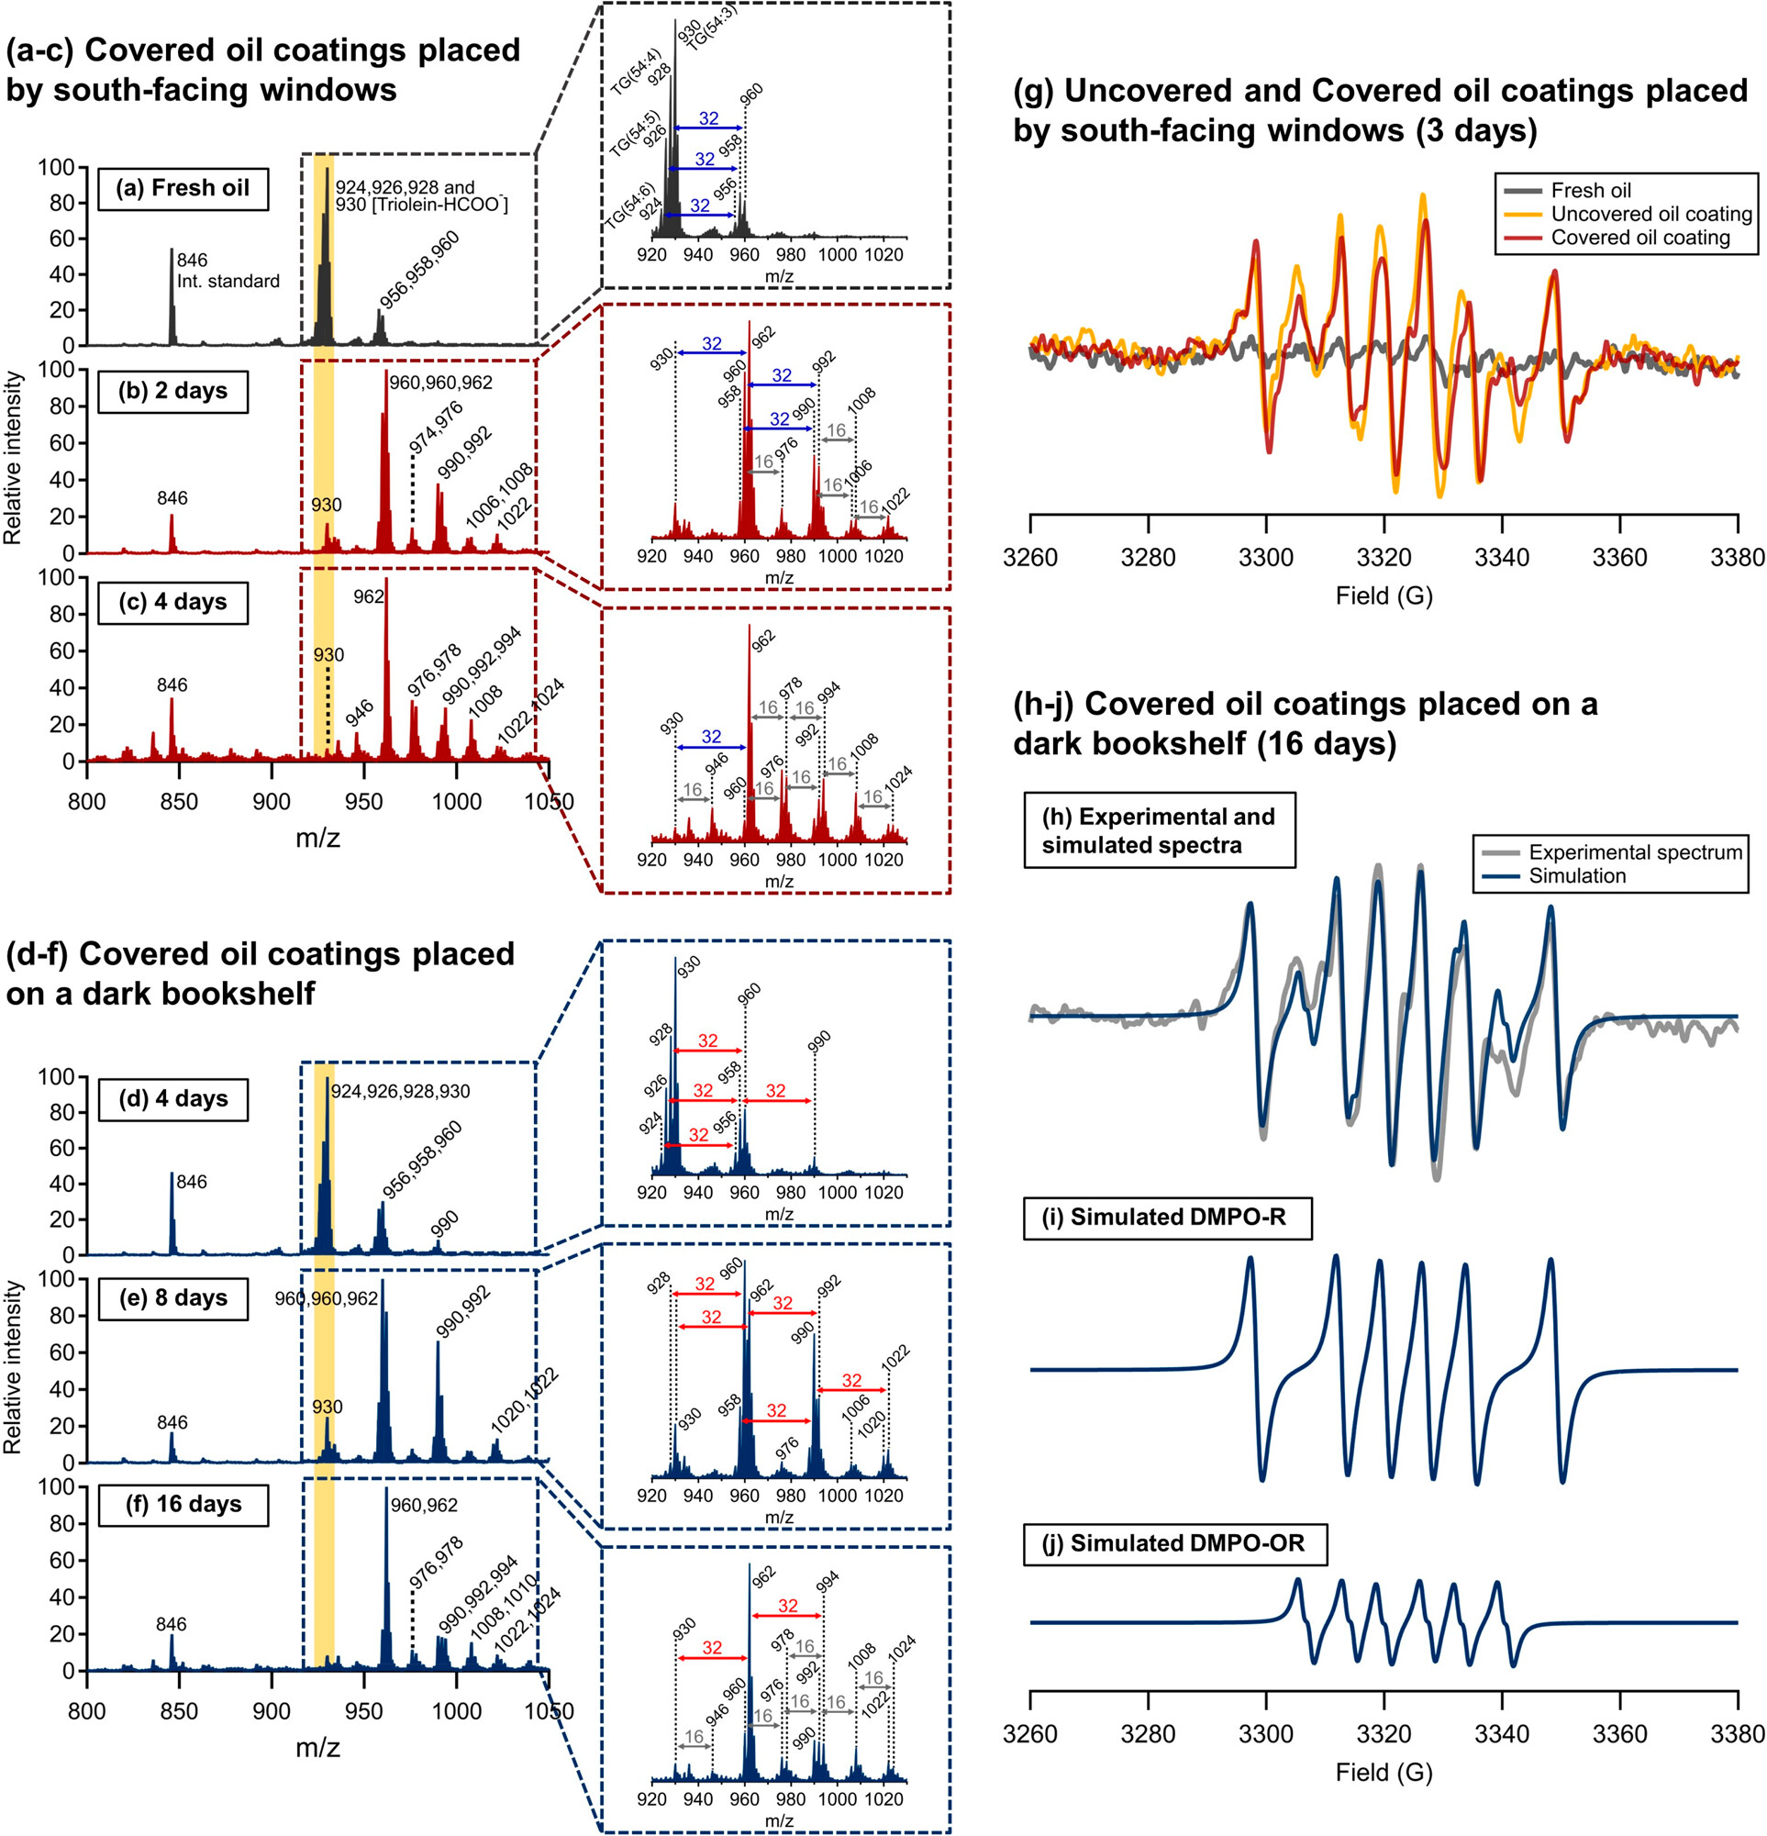
Result
3.Effects of Indoor Lighting
(fully exposed to room air)
Notes:
further characterized the photochemical aging process through (negative ion mode) ESI-MS，due to the weak product signals in NMR spectra,.
Figure a−c shows that the irradiated coatings underwent rapid triglyceride degradation in 4 days (m/z 924−930 highlighted in yellow) .Meanwhile, higher molecular-weight products were observed through the new signals marked with m/z increments of 32.
This chemical transformation is in stark contrast to the identical sample kept on a dark bookshelf (Figure d), which remained relatively intact for at least 4 days. After this induction period (诱导期), however, the covered coating on the dark bookshelf underwent autoxidation (Figure e,f). This observation was consistent with the uncovered coatings placed inside the drawer described in the previous section.
When light was blocked at the window location, the oil remained inactive for 4 days, indicating that a warmer temperature by the window did not trigger
peroxidation. Generally, it is believed that lipid photooxidation is driven by photosensitizers in cooking oils (叶绿素), leading to photosensitized oxidation.
在光照射后，被激活的光敏剂可以:(i)从脂质中提取氢原子或(ii)与分子氧发生反应。即使没有光敏剂的作用，室内阳光也是引发过氧化反应的强诱因（其他实验证明)。

Slide 18
Conclusion
Unsaturated oils chemical fates :
(1) In ozone-abundant environments (≥5 ppb, minimum observed value), ozonolysis is the dominant mechanism.
(2) Indoor locations with extremely low air flow and ozonemixing ratios will make lipid peroxidation mechanisms more significant, especially when direct sunlight is available.
Notes:
Unsaturated oils chemical fates can be characterized through two major multiphase oxidation pathways.
(1) This rapid chemical transformation makes the films highly dynamic, affecting the surface reactivity.(在不过度暴露于高温或阳光下的情况下，即使在较高的相对湿度下，高粘性SOZs也能保持高稳定性12天、72天至88个月由于这个原因，活性表面污染物在SOZs覆盖下可能有更长的寿命。)Further epidemiological studies are needed to better evaluate the underlying health impacts.

Slide 19
Conclusion
Novelty & Significance:
Photooxidation happens in human skin lipids after UVA radiation. UVC lights (λ ≤ 254 nm) could further enhance lipid reactivity by producing indoor OH, well-known initiator in lipid autoxidation.
In dark environments, OH concentrations can be enhanced through cooking events or gas-phase ozonolysis of oxidized skin oils. Additionally, metals present in cooking oils or on indoor surface materials are also potential initiators.
the observed peroxidation behavior unveils specific environments where radical-mediated mechanisms may prevail.

Slide 20
THANKS
许继文
2023.09.15

